Slide 1
Warby Parker Marketing Analysis
Learn SQL from Scratch
Mary Zhou
5/16/2019

Slide 2
Quiz Funnel

Slide 3
Columns Found in Style Quiz
The Style Quiz has 3 columns:
question
User_id
response

Slide 4
Number of Responses to Each Question
These are the questions that we ask in the Style Quiz and the number of responses received for each question.
We’ve formatted the questions so the user needs to reply to the current question on the page before going to the next question.
Question | Response Count
1. What are you looking for? | 500
2. What’s your fit? | 475
3. Which shapes do you like? | 380
4. Which colors do you like? | 361
5. When was your last eye exam? | 270

Slide 5
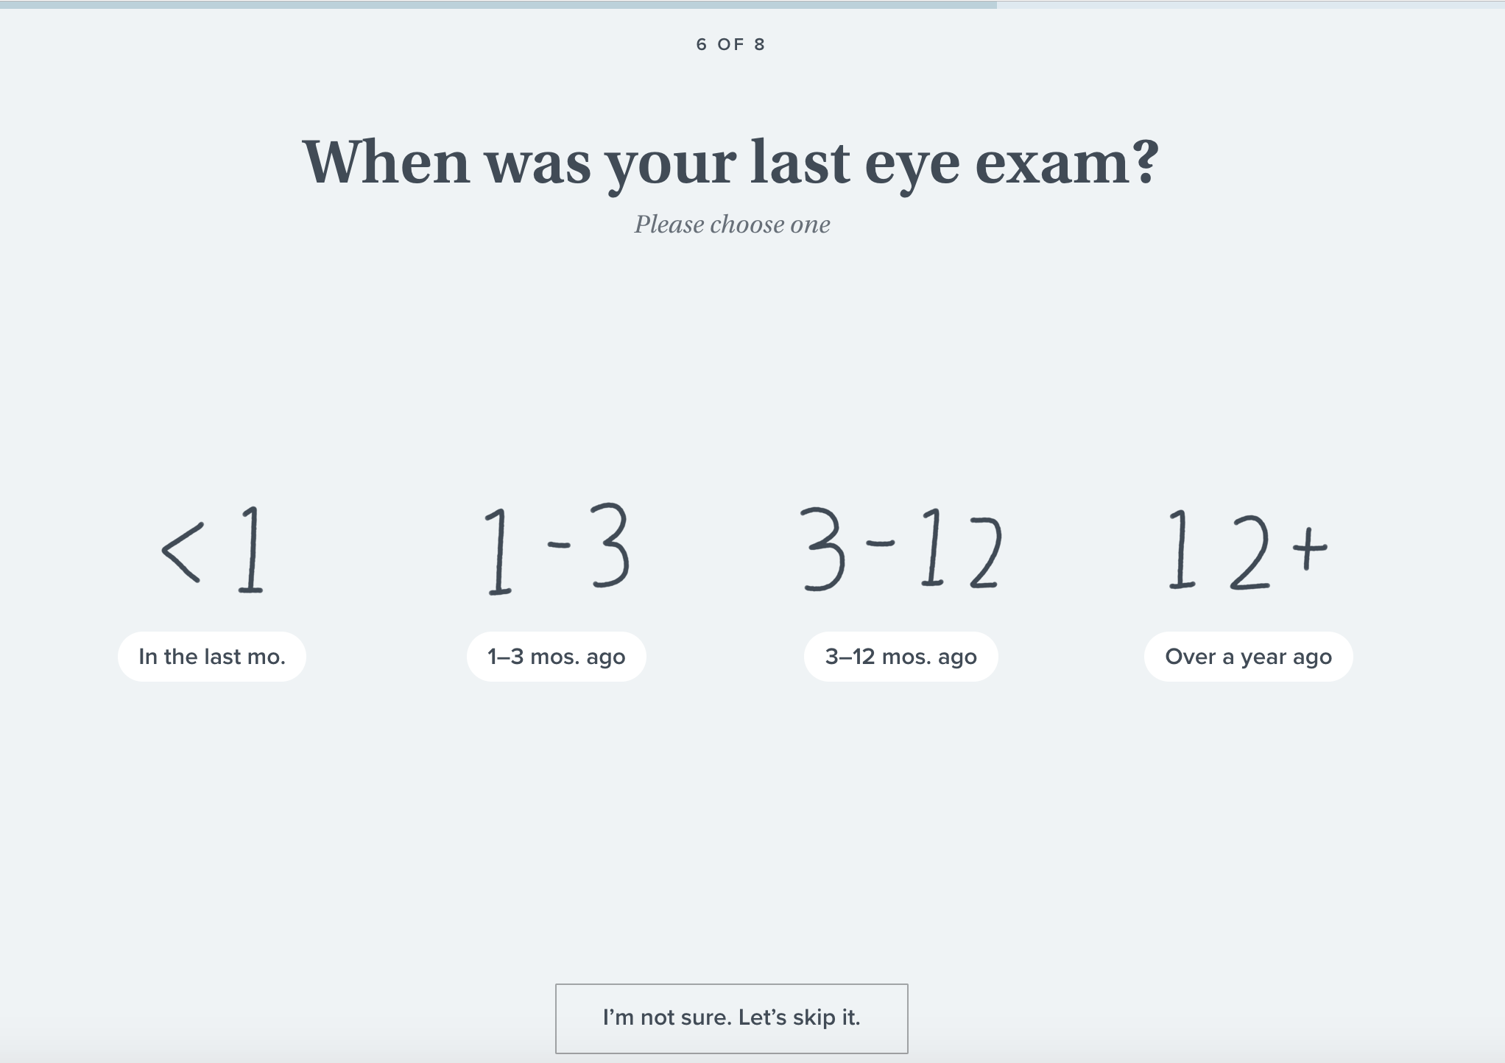
Why Question 5 Has the Lowest Responses
Question | Percent of Reponses
What are you looking for? | 100.00%
What's your fit? | 95.00%
What shapes do you like? | 80.00%
Which colors do you like? | 95.00%
When was your last eye exam? | 74.79%
The question with the lowest response percentage is the last question with ~75%. The reason for this low response could be due to the fact that most people do not remember when their last exam was. Because Warby Parker offers a “I’m not sure. Let’s skip it.” option, people will tend to choose that over guessing.

Slide 6
Home Try-On Funnel

Slide 7
Columns in Quiz, Home Try-On, and Purchase
The Quiz has 5 columns:
user_id
style
fit
shape
color
The Home Try-On has 3 columns:
user_id
number_of_pairs
address
The Purchase has 6 columns:
user_id
product_id
style
model_name
color
price

Slide 8
Conversions By Funnel
Quiz
From users that take the quiz to doing home try-ons is about 75%.
Users who went from home try-on to purchasing is about 66%.
Overall the conversion rate is doing well.
75%
Home Try-On
66%
Purchase

Slide 9
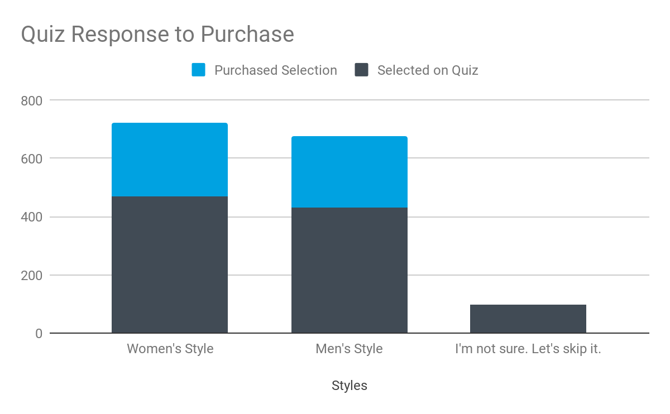
The Most Popular Style
The women’s style is currently the most popular style that our users are looking for based on the Style quiz.
Women’s style has also been purchased more than men’s style. 54% of the users who answered “women’s style” on the quiz ends up purchasing.
We should consider running more ads directed towards women in our marketing.

Slide 10
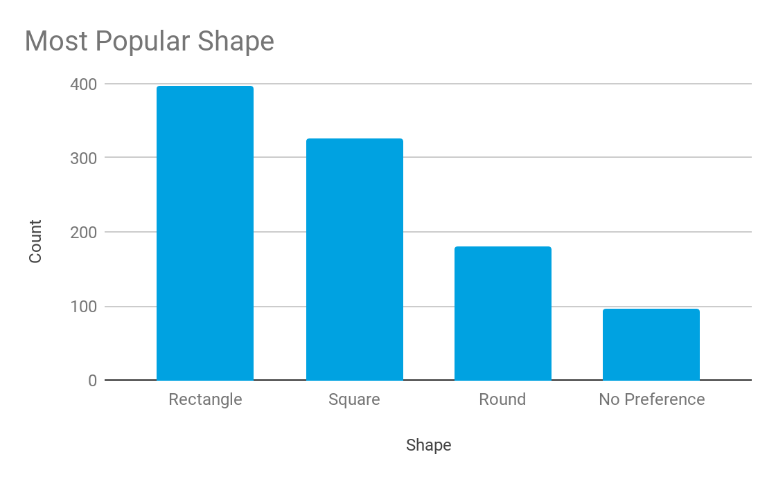
The Most Popular Shape
The most popular shape, with 397 people (40% of the results) choosing it, is rectangular. On our website, we should be highlighting more rectangular frames as our “Staff Picks” and creating more designs for this shape.

Slide 11
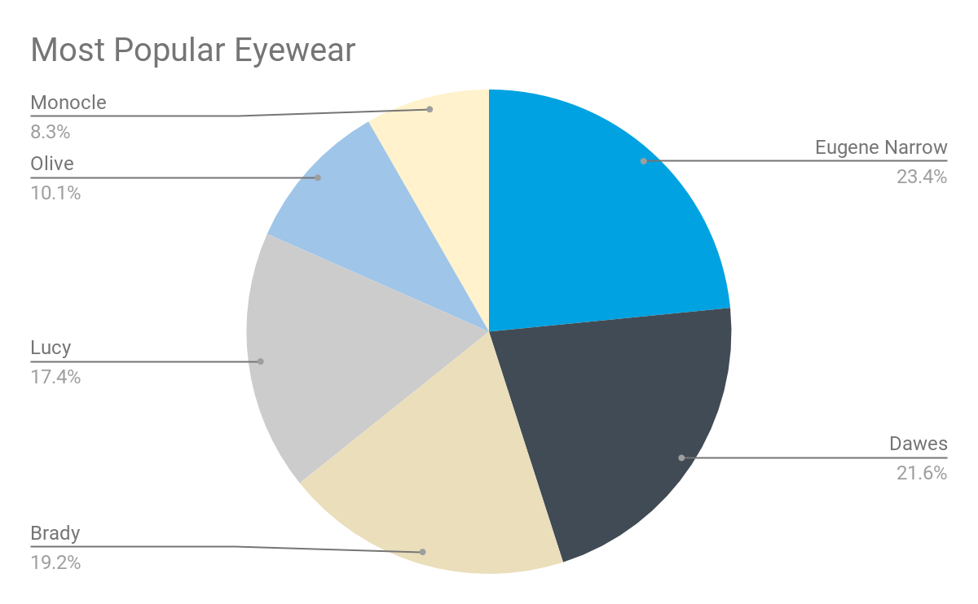
The Most Purchased Eyewear
The most purchased eyewear was the Eugene Narrow in Rosewood Tortoise. There were 116 purchases.
When we run ads directed at women, we should consider featuring this model. We should also add a “Staff Picks” badge to it.

Slide 12
Conclusion
We should be focused on highlighting rectangular shapes.
We should increase digital ads targeted towards women.
In the ads, we can feature the Eugene Narrow frames as they are our most purchased frames.

Slide 13
Thank you!

